Slide 1

ADDIS ABABA SCIENCE AND TECHONOLOGY UNIVERSITY
College of Electrical and Mechanical Engineering
Departments of Electrical and Computer Engineering
(Computer Engineering Stream)
BSc. Final Year Project
Title
Computer Vision Based Authentication and Employee monitoring System
June 22, 2022

Slide 2
Project Contributors
Students Name
ID. No
Getachew Getu ETS0557/10
Yinebeb Tariku ETS1263/10
Yosef Emyayu ETS1310/10
Advisor name
Mr. Ashenafi Yadesa
i

Slide 3
Outline
Introduction
Statement of Problem
Objective
Methodology
Testing, results and discussions
Conclusion and recommendation
Future work
References
1

Slide 4
Introduction
Computer vision(CV) is a field of computer science that deals with replicating the complex parts of the human visual system and getting the machines to understand the visual details present in a data.[1]
CV enables computers and systems to derive meaningful information from digital images, videos and take actions or make recommendations based on that information.[1]
Face detection and recognition are the most important application in computer vision.
Face detection is the process of simply detecting the presence of a face in an image or video stream.
Face recognition takes the faces detected from the localization phase and attempts to identify whom the face belongs to.
2

Slide 5
Statement of problems
Strong and multifactor authentication system are needed at the current situation in many sectors.
we cannot trust the conventional methods namely a manual lock at the door, password keylock can be guessed/observed and token card can be stolen.
The existing attendance system
requires employees to manually sign on a sheet every time they attend their work.
This adds more extra time to be consumed by the employee to find their name on sheet,
Some employees may mistakenly signed other’s name and sometimes sheet may get lost.
To solve those problem, we tried to design and implement a better authentication and employee monitoring system by using computer vision particularly via face recognition.
3

Slide 6
Objective
The main objective of this project is to develop multifactor authentication and employee monitoring system by using computer vision.
Specific objective
To utilize the face recognition system based on OpenCV.
To design and develop multifactor password authentication system.
To generate and record user’s data who have been access the system.
To design highly reliable and efficient and automated door opening-closing mechanism.
4

Slide 7
Scope of the project
In-scopes
Authentication and taking attendance with employee’s facial features.
For fog and smog weather conditions, we add a two-factor authentication.
For unregistered person, guest mode option included.
work only for local connection between admin and the system.
Out-scopes
The remote server connection between the admins and the system.
The case where employee may leave the staff once they take attendance.
A possible entrance of a person other than the registered one at time of door opening.
Possible trial of opening the door via registered person’s face image.
5

Slide 8
Methodology
The general procedure in doing the proposed system is as follow in the figure below.
Problem identification
Literature review
Data collection
Discussion and conclusion
Data analysis
Figure-1 Procedures we follow in the project
we will be used the Local Binary Pattern Histogram(LBPH ) face detection algorithm.
Also, at the detection stage, we used the LBPH based Haar-cascaded recognizer as a classifier.
These algorithms are prebuilt-in by enthusiasts and we used them since they are tested and recommended.
6

Slide 9
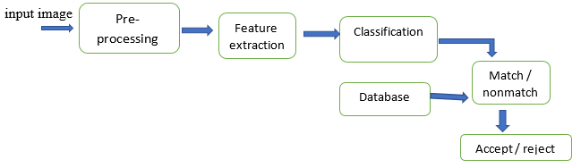
Con’t…
The detail procedures
We will feed 30 number of face images per user to the LBPH Algorithm.
We divide the training phases into preprocessing, feature extraction and classification phases.
Figure-2 flow of operation
7

Slide 10
Con’t…
preprocessing
At first, it converts color images to gray scale images and
Each face image will convert into pixels and will divides the image into various pieces then it stores the values of each pixel.
Feature extraction
In this stage the facial feature like mouse, nose, and eyes will take and their correlation will generated and these data will replace the face images in the form of pythons data-frame, previously converted from an array.
The algorithm will do all the detail of the feature extractions.
Classification phase
At this stage, based on the features take in the above phase, the recognizer will made a classification to group faces those are related and will generate a data in the form an arrays, and following it will stored in the form of trainer.xml.
8

Slide 11
Con’t…
Recognition phase
At this stage, we have a model which was trained over the registered employees face data.
After this, the system can detect a person and will identify his identity based on his face image – face recognition.
The system take person’s face data at from the camera and once doing the preprocessing phase, it will compare with the existing face data with in the trained model.
Once a match with the specified confusion matrix found, the face is known recognized, else the face is said to be ‘unknown’.
For the first case, the door will opened, the person welcomed, and will closed after the specified period of time- (30seconds). At this stage, attendance for the recognized person will taken.
For the second case, when the face get unknow, the system will keep the person to try other means to get access at the gate – guest mode!
9

Slide 12
Unknown face…
At the recognition phase, there are more than one possibilities:
The person may not positioned appropriately in front of the camera, or
The light intensity may varied too much from the conditions were the training was made.
We only considered the second case only, since the first case seems obvious.
Our system will recognize this situation when there is no face detected at the camera once the system is at recognition phase.
Two factor authentication
The person at the moment will entertained to try two factor authentication.
The system request a username and password, user will forward via the keypad and the communication with the system is interfaced via a liquid crystal display(LCD).
The system will generate 4-digit one time password(OTP) which will expired after 30seconds, and it will sent to the respective email address.
User will entered this via the keypad, and if the generated OTP and the the user’s input are equal with in the specified time- otpage, the door will opened and the other task will done as a detected person.
10

Slide 13
Guest mode…
When the person detected ‘Unknow’, we added a guest mode option.
A new, unregistered person will prompt to try a guest mode and his request will forward to the admins email, based on the response he will get or denied access.
The email contains three images of the guest, a onetime password from the system and guest’s phone number.
If the admin grant permission, he will call and tell the otp, guest entered and the system will let him get access.
If admins denied the request, the system will tell the guest and continue to the normal operation – looking for a person.
11

Slide 14
Employee monitoring…
At time of detection attendance will taken into forms,
A report which contain every track of the systems detection.
A summary of attendance which contain one record for a user per a day.
Both can be seen in a form of csv file, once generated via a button from the admin’s window.
For the registration, training and recognition processes, see the flowchart diagram.
12

Slide 15
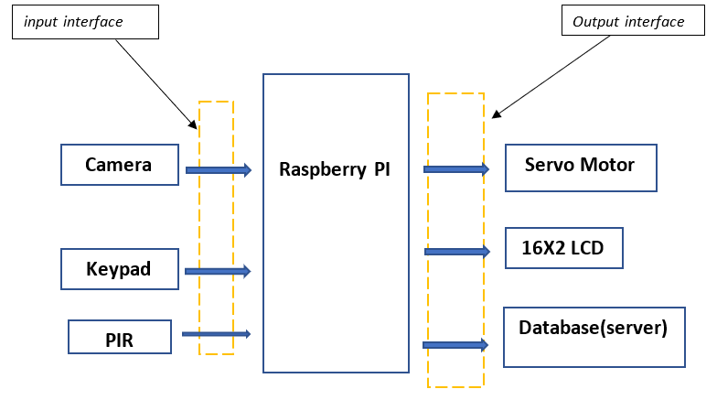
Systems design(components)
We follow the following components connectivity in doing the project.
Figure-3 our system design
13

Slide 16
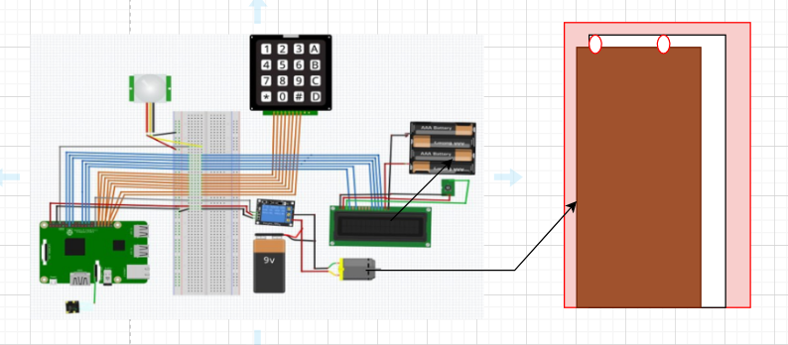
Components connectivity
Components are connected and configured as shown below
Figure-4 Components connectivity, electrical and mechanical design system
14

Slide 17
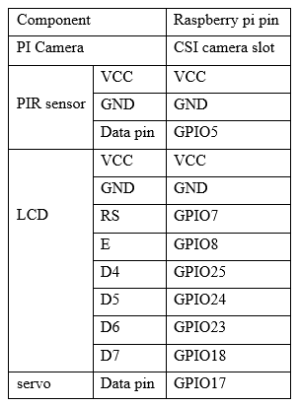
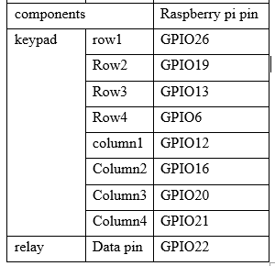
Components connectivity
Summary of component connection
Table-1 component pin connection
15

Slide 18
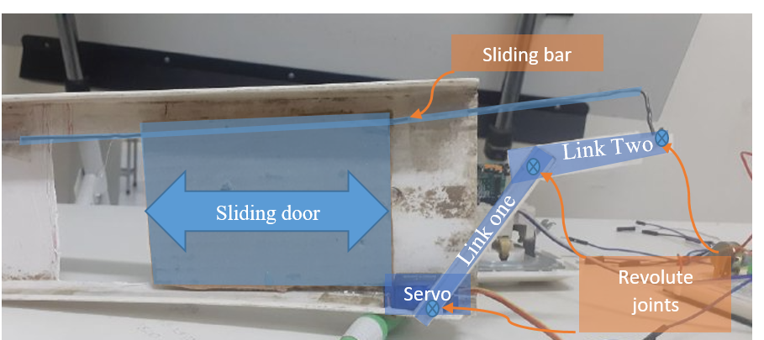
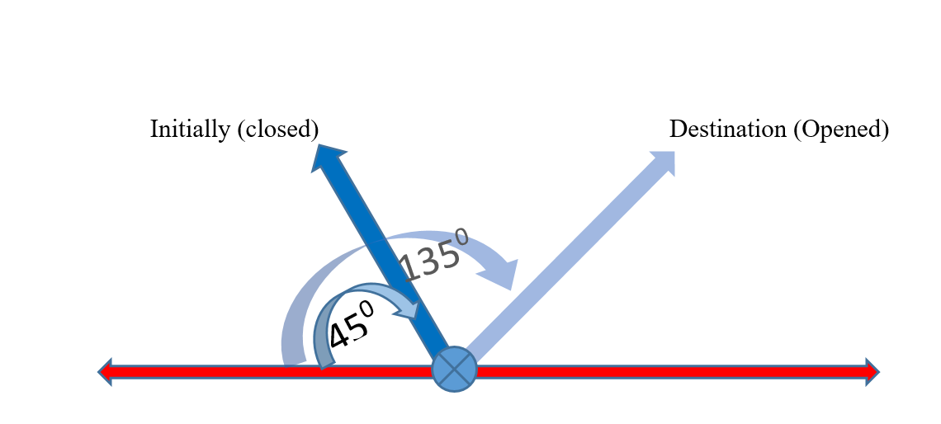
Door’s closing – opening mechanism
Figure-5 Mechanical design for controlling door movement
16

Slide 19
Code implementation
Software used
Some of the software(python libraries) used are:
TKinter provides a powerful object-oriented interface to the Tk GUI toolkit.
Time module is used to manage time related tasks.
GPIO pins to declare pins of the raspberry pi.
SQLite provides a lightweight disk-based database that doesn’t require a separate server process
Python scripts in the project folder
Headshot.py
Recognition.py
Train_model.py
Database.py
Otp.py
Guest.py
Admin.py
Main.py
17

Slide 20
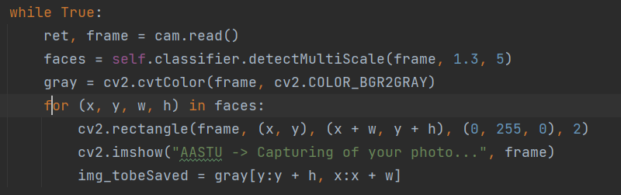
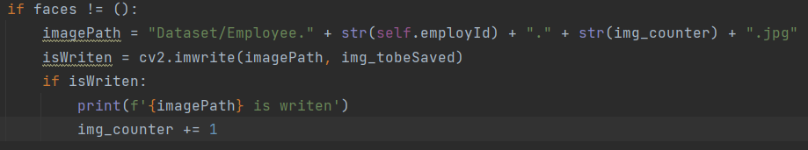
Sample code snipest(from headshot.py)
Below code loop over the frames of person’s face and putting in an array of data is given below
code to save a gripped image into image directory
18

Slide 21
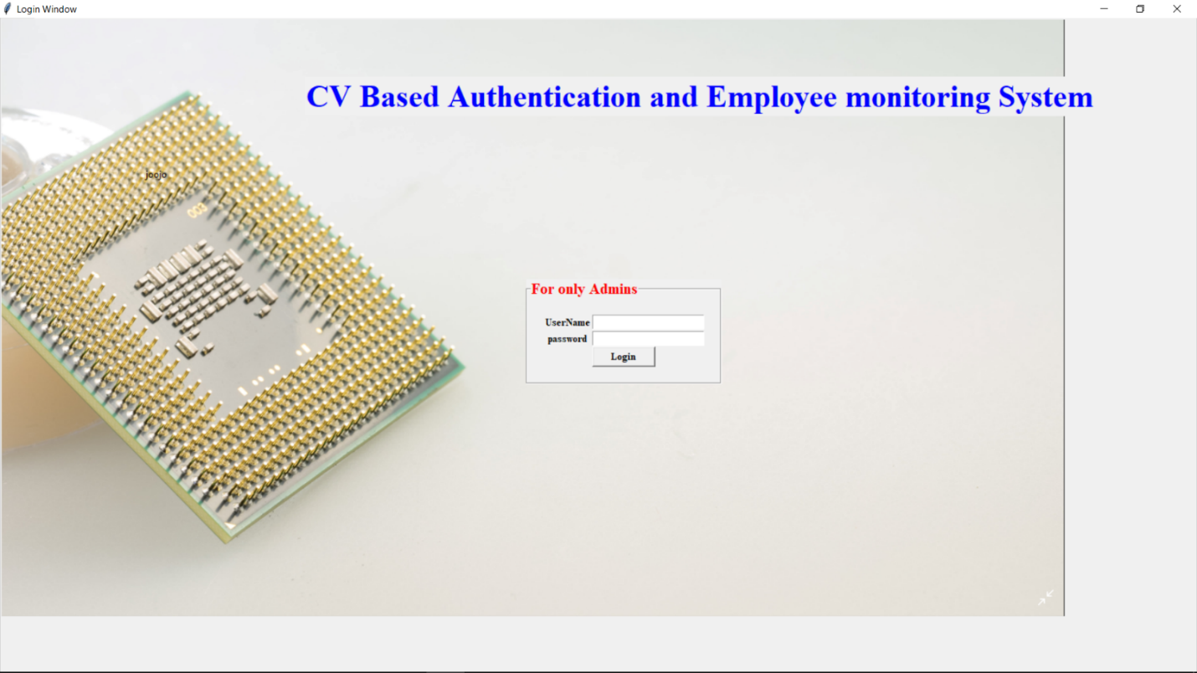
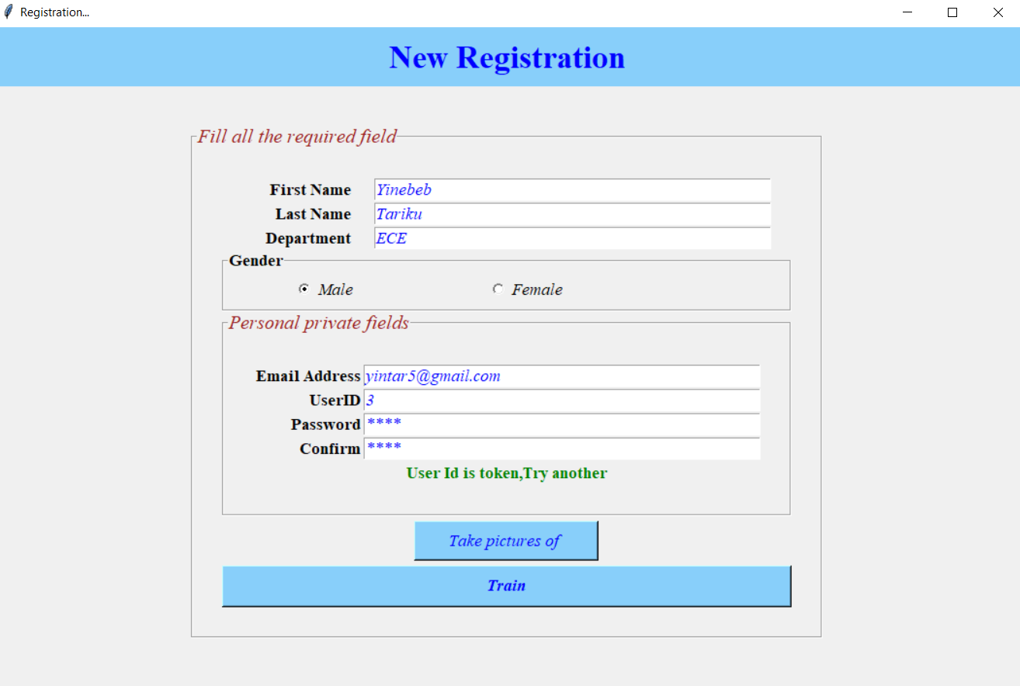
Result, testing and discussion
GUI’s result…
Admin login window
Registration window
Figure-6 a) admin login page
b) registration window
19

Slide 22
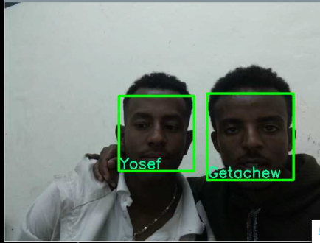
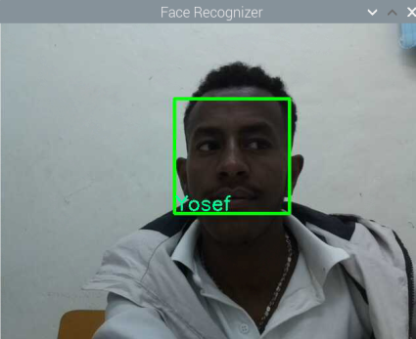
Testing and Results
Recognition phase, sample result screenshot,
In the first, both Yosef and Getachew were registered before, and the system recognize them at a time.
The second screenshot show for a single person –Yosef’ recognition.
Figure-6 Recognition – testing result
20

Slide 23
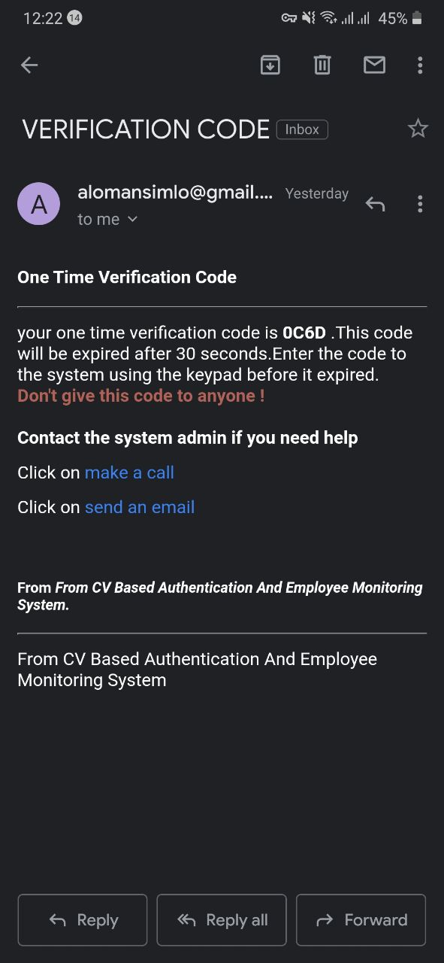
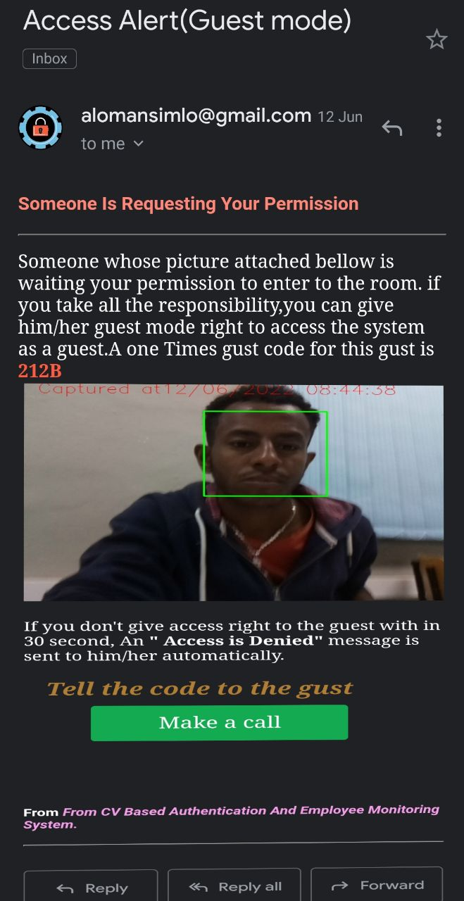
Testing and Results
Email verification (OTP) during fog weather condition
Guest-mode email notification
Figure-7 a).Email verification (OTP) during fog weather condition
b).Guest mode email notification
21

Slide 24
Conclusion and recommendation
Conclusion
we have implemented computer vision-based authentication and employee monitoring system.
we have used local binary pattern histogram LBPH algorithm for face recognition system.
The authentication is based on face images taken from the streaming video with raspberry pi camera.
The system has user mode and guest mode. The attendance generation-taking feature minimize the drawback of manual attendance system.
We have implemented two factor password authentication system with email notifications.
At the testing case, when the motion is detected, the camera is initialized. The faces are compared with the previously trained image. If the face is Match, then the system will be recognized, the door is opened and the attendance is generated simultaneously.
22

Slide 25
Recommendation
This project is aim to applicable in home’s (rooms) door, data center and offices by using face recognition systems by providing more authentication.
We recommend any interested individuals and companies to try this system and hope they will get an expected result as we depicted in the systems detail description.
We are happy to work and deploy the prototype-level project on a real industry-level along technical help of our advisors.
23

Slide 26
Future work
Developing an algorithm where images can taken and processed to have similar and constant light intensity via the camera at any conditions equally.
Redoing the system equally for remote server connection.
Considering and come up with an effective means to detect and take a measure when another person get into the room with the reigistered employee at time of door opening.
Developing one additional algorithm to identify either a face is from persons’ face or from an image.
24

Slide 27
Thank you!
25

